Slide 1
Chapter 1
Overview of Electronic Commerce

Slide 2
Learning Objectives
Define electronic commerce (EC) and describe its various categories.
Describe and discuss the content and framework of EC.
Describe the major types of EC transactions.
Describe the digital revolution as a driver of EC.
Describe the business environment as a driver of EC.

Slide 3
Learning Objectives
Describe some EC business models.
Describe the benefits of EC to organizations, consumers, and society.
Describe the limitations of EC.
Describe the contribution of EC to organizations responding to environmental pressures.
Describe online social and business networks.

Slide 4
Electronic Commerce:
Definitions and Concepts
electronic commerce (EC)
The process of buying, selling, transferring, or exchanging products, services, or information via computer networks.

Slide 5
Electronic Commerce:
Definitions and Concepts
e-business
A broader definition of EC that includes not just the buying and selling of goods and services, but also servicing customers, collaborating with business partners, and conducting electronic transactions within an organization.

Slide 6
Electronic Commerce:
Definitions and Concepts
PURE VERSUS PARTIAL EC
  EC Organizations
    brick-and-mortar (old economy) organizations
    Old-economy organizations (corporations) that perform their primary business off-line, selling physical products by means of physical agents.
    virtual (pure-play) organizations
    Organizations that conduct their business activities solely online.

Slide 7
Electronic Commerce:
Definitions and Concepts
    click-and-mortar (click-and-brick) organizations
    Organizations that conduct some e-commerce activities, usually as an additional marketing channel.

Slide 8
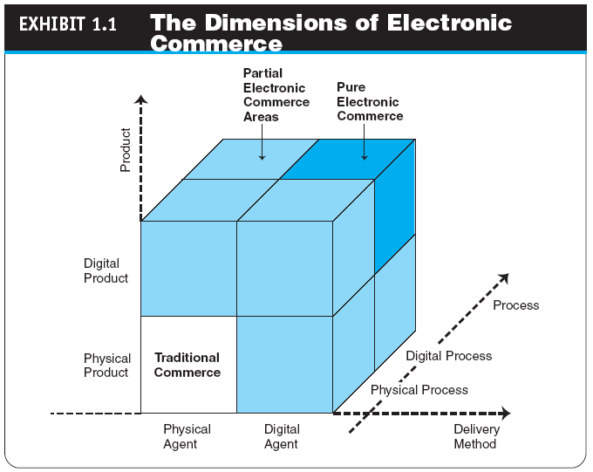
Electronic Commerce:
Definitions and Concepts
1.1

Slide 9
Electronic Commerce:
Definitions and Concepts
INTERNET VERSUS NON-INTERNET EC
  intranet
  An internal corporate or government network that uses Internet tools, such as Web browsers, and Internet protocols.
  It is different from Internet.
  extranet
  A network that uses the Internet to link multiple intranets.

Slide 10
Electronic Commerce:
Definitions and Concepts
electronic market (e-marketplace)
An online marketplace where buyers and sellers meet to exchange goods, services, money, or information.

Slide 11
Electronic Commerce:
Definitions and Concepts
Interorganizational information systems (IOSs)
Communications systems that allow routine transaction processing and information flow between two or more organizations.
intraorganizational information systems
Communication systems that enable
e-commerce activities to go on within individual organizations.

Slide 12
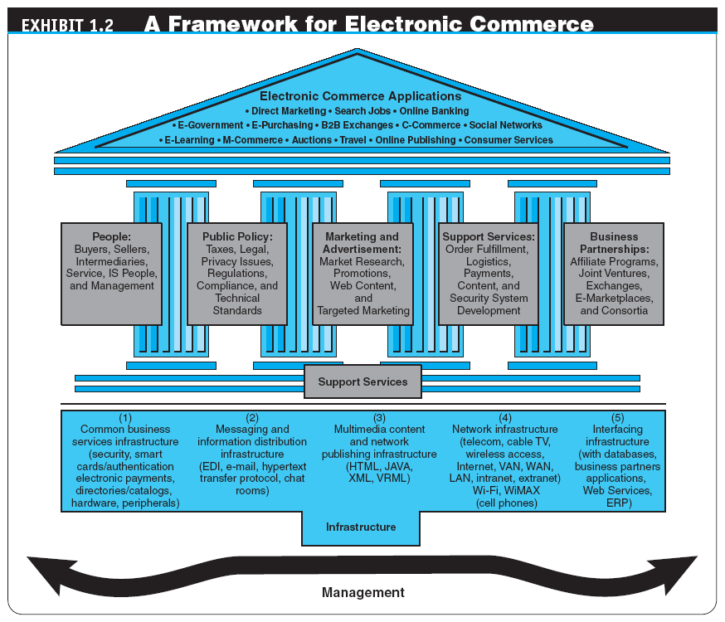

Slide 13
The EC Framework,
Classification, and Content
CLASSIFICATION OF EC BY THE NATURE OF THE TRANSACTIONS OR INTERACTIONS
  business-to-business (B2B)
  E-commerce model in which all of the participants are businesses or other organizations.
  business-to-consumer (B2C)
  E-commerce model in which businesses sell to individual shoppers.

Slide 14
The EC Framework,
Classification, and Content
  business-to-business-to-consumer (B2B2C)
  E-commerce model in which a business provides some product or service to a client business that maintains its own customers.

Slide 15
The EC Framework,
Classification, and Content
  consumer-to-business (C2B)
  E-commerce model in which individuals use the Internet to sell products or services to organizations or individuals who seek sellers to bid on products or services they need.
  mobile commerce (m-commerce)
  E-commerce transactions and activities conducted in a wireless environment.

Slide 16
The EC Framework,
Classification, and Content
  location-based commerce (l-commerce)
  M-commerce transactions targeted to individuals in specific locations, at specific times.
  intrabusiness EC
  E-commerce category that includes all internal organizational activities that involve the exchange of goods, services, or information among various units and individuals in an organization.

Slide 17
The EC Framework,
Classification, and Content
  business-to-employees (B2E)
  E-commerce model in which an organization delivers services, information, or products to its individual employees.
  collaborative commerce (c-commerce)
  E-commerce model in which individuals or groups communicate or collaborate online.
  consumer-to-consumer (C2C)
  E-commerce model in which consumers sell directly to other consumers.

Slide 18
The EC Framework,
Classification, and Content
  peer-to-peer
  Technology that enables networked peer computers to share data and processing with each other directly; can be used in C2C, B2B, and B2C e-commerce.
  e-learning
  The online delivery of information for purposes of training or education.
  e-government
  E-commerce model in which a government entity buys or provides goods, services, or information from or to businesses or individual citizens.

Slide 19
The EC Framework,
Classification, and Content
Web 2.0
The second-generation of Internet-based services that let people generate content, collaborate, and share information online in perceived new ways—such as social networking sites, wikis, communication tools, and folksonomies.

Slide 20
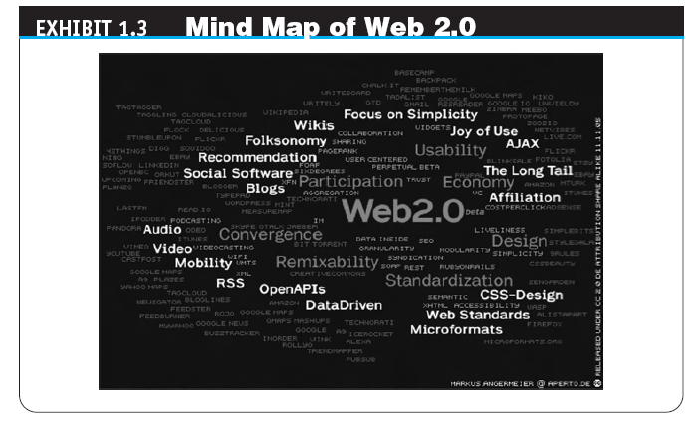
The EC Framework,
Classification, and Content

Slide 21
The Digital Revolution
Drives E-Commerce
digital economy
An economy that is based on digital technologies, including digital communication networks, computers, software, and other related information technologies; also called the Internet economy, the new economy, or the Web economy.

Slide 22
The Digital Revolution
Drives E-Commerce
The digital revolution accelerates EC mainly by providing competitive advantage to organizations.
The digital revolution enables many innovations

Slide 23
The Business Environment
Drives E-Commerce
THE BUSINESS ENVIRONMENT
  The Business Environment Impact Model (see next slide)
  Business Pressures and Opportunities (see Exhibit 1.6 on page 20)
  - market (economic), societal, and technological
  Organizational Response Strategies
  (see next slide for Exhibit 1.7 on p. 21)

Slide 24
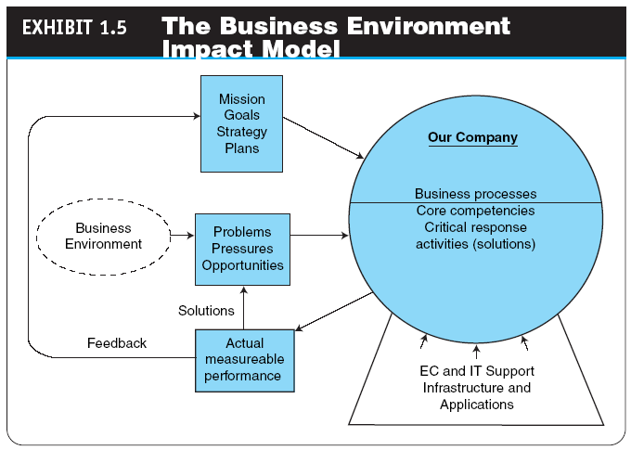
The Business Environment
Drives E-Commerce

Slide 25
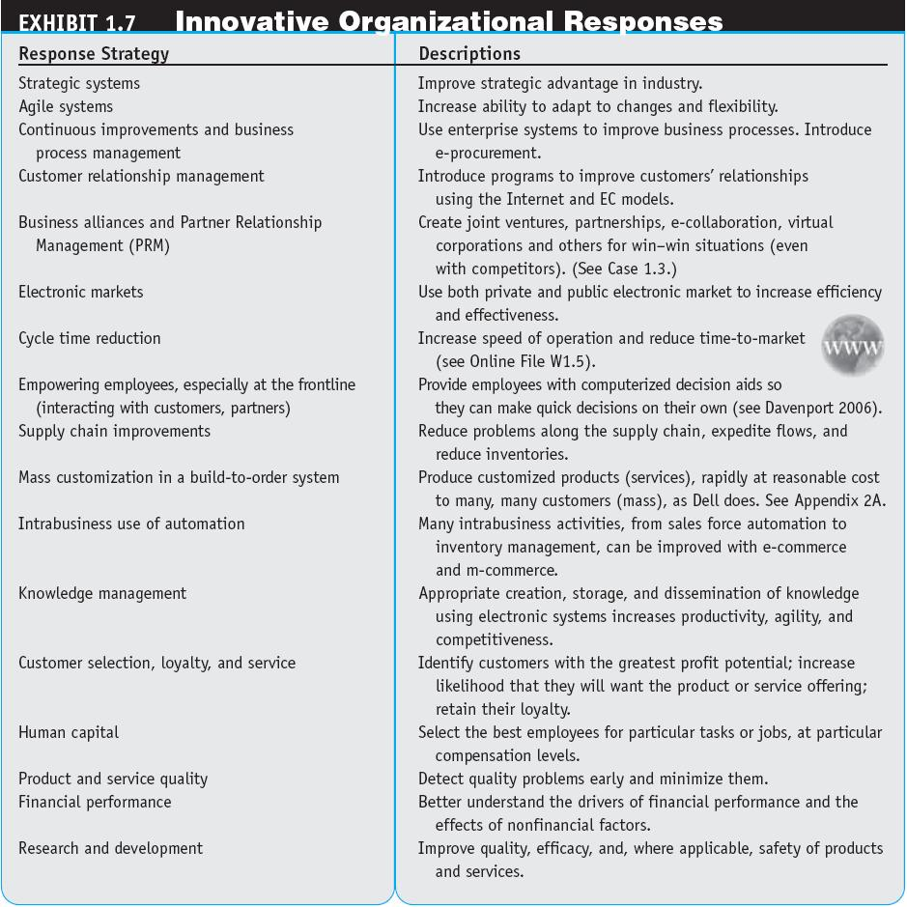

Slide 26
EC BUSINESS MODELS
business model
A method of doing business by which a company can generate revenue to sustain itself.

Slide 27
EC BUSINESS MODELS
TYPICAL EC BUSINESS MODELS
  Online direct marketing
  Electronic tendering systems for procurement
    tendering (bidding) system
    Model in which a buyer requests would-be sellers to submit bids; the lowest cost or highest value bidder wins.
  name-your-own-price model
  Model in which a buyer sets the price he or she is willing to pay and invites sellers to supply the good or service at that price.

Slide 28
EC BUSINESS MODELS
  Find the best price
    also known as a search engine model
  affiliate marketing
  An arrangement whereby a marketing partner (a business, an organization, or even an individual) refers consumers to the selling company’s Web site.
  viral marketing
  Word-of-mouth marketing in which customers promote a product or service to friends or others.

Slide 29
EC BUSINESS MODELS
  group purchasing
  Quantity (aggregated) purchasing that enables groups of purchasers to obtain a discount price on the products purchased.

Slide 30
EC BUSINESS MODELS
  Online auctions
  Product customization and service personalization
    customization
    Creation of a product or service according to the buyer’s specifications.
    personalization
    The creation of a service or information according to specific customer specifications.

Slide 31
EC BUSINESS MODELS
  Electronic marketplaces and exchanges
  Information brokers (infomediaries)
  Bartering: Companies use bartering to exchange surpluses they don’t need for things that they need
  Value-chain integrators (the model offers services that aggregate information rich products into a more complete package for customers, thus adding value. E.g., Carpoint.com provides several car-buying-related services, such as financing and insurance)

Slide 32
EC BUSINESS MODELS (continued)
  Value-chain service providers (these providers specialize in a supply chain function such as logistics (UPS.com) or payments (payPad.com)
  Supply chain improvers (one of the major contributions of EC is in the creation of new models that change o improve supply chain management such as converting a linear supply chain to a hub)
  Social networks, communities, and blogging
  Negotiation

Slide 33
Benefits and Limitations of EC
THE BENEFITS OF EC (see next slide for Exhibit 1.8 on p. 28)
  Benefits to Organizations
  Benefits to Consumers
  Benefits to Society
  Facilitating Problem Solving

Slide 34
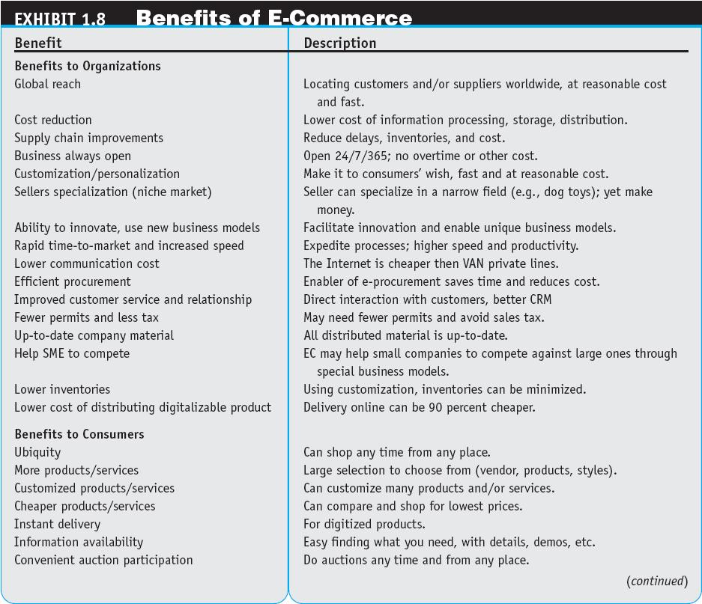

Slide 35
Benefits and Limitations of EC
THE LIMITATIONS AND BARRIERS OF EC (See nest slide for Exhibit 1.9 on p. 30)
  Technological Limitations
  Nontechnological Limitations

Slide 36
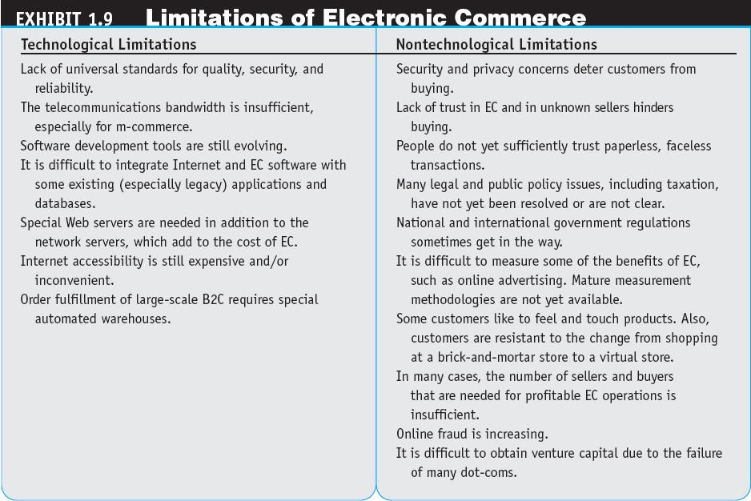

Slide 37
The Digital Enterprise
digital enterprise (See next slide for Exhibit 1.10 on p. 34)
A new business model that uses IT in a fundamental way to accomplish one or more of three basic objectives:
- reach and engage customers more effectively,
- boost employee productivity,
- improve operating efficiency
It uses converged communication and computing technology in a way that improves business processes.

Slide 38
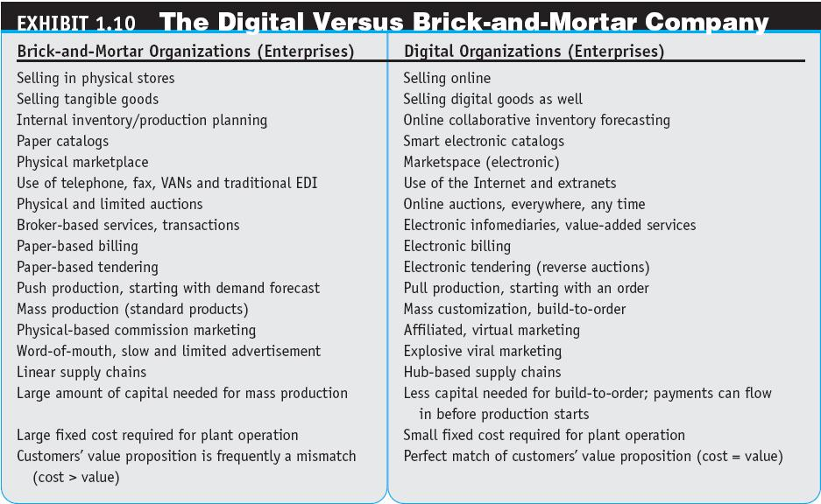

Slide 39
The Digital Enterprise
corporate portal
A major gateway through which employees, business partners, and the public can enter a corporate Web site.

Slide 40
Summary
Definition of EC and description of its various categories.
The content and framework of EC.
The major types of EC transactions.
The role of the digital revolution.
The role of the business environment as an EC driver.

Slide 41
Summary
The major EC business models.
Benefits of EC to organizations, consumers, and society.
Barriers to EC.
Social and business online networks.

